Slide 1
EART 28202 : Structural Geology
Class 4 : Shear Zones
Notes:
In the notes panes to these slides there are numerous references (figure credits and further reading). If the reference is incomplete it refers to the references stated in the reading list on the last slide
With regard to figures in this PowerPoint file, many will be subject to copyright restrictions. I don’t care about you using any of the figures/photos that are mine (Steve Covey-Crump), although a credit would be nice, but take care to comply with copyright restrictions if you reuse any that are not

Slide 2
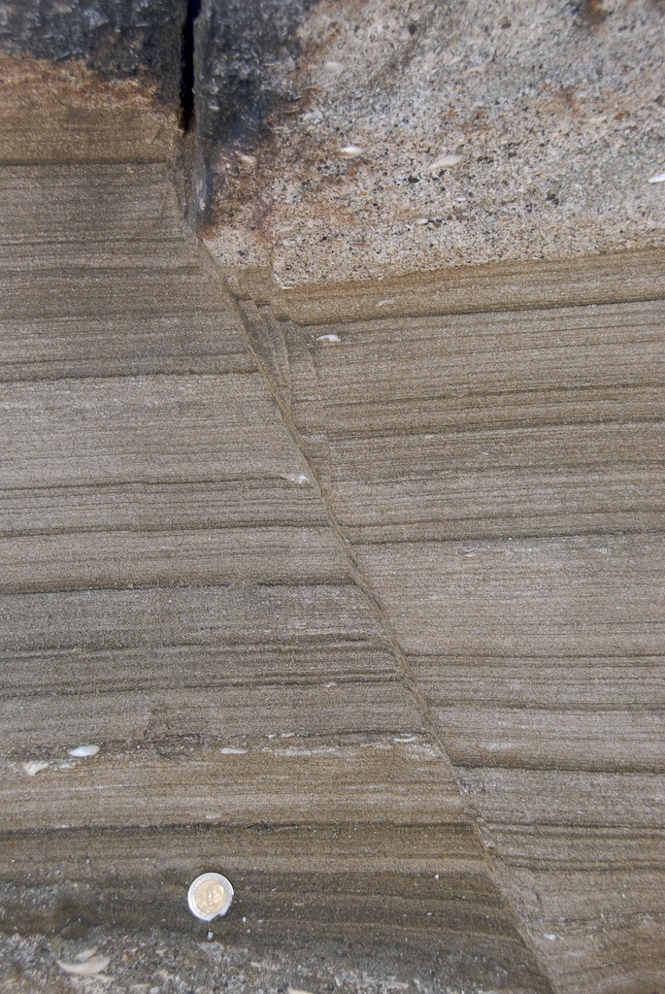
Localization of deformation
During natural deformation strain tends to be localized into zones
The most obvious example of this is a fault where almost all the deformation is accommodated within a narrow zone surrounding the fracture surface
Regions of highly localized deformation are described as shear zones
Shear zones can form at all depths within the lithosphere, and at all scales – from the sub-microscopic up to the scale of a plate boundary where the shear zone penetrates the whole lithosphere
Displacements across shear zones correspondingly range from the miniscule to 100s of kilometres
Notes:
For a summary of the nomenclature (definitions) of various types of structural discontinuities (joints, faults, fractures, shear zones, deformation bands) see Schultz & Fossen, 2008, American Association of Petroleum Geologists Bulletin 92: 853-867, https://doi.org/10.1306/02200807065
Photo (Fossen, one of the extra figures on the web-site for the book, folk.uib.no/nglhe/StructuralGeoBook.html): a fault at Moreno Bay, Antofagata, Chile. Note that in the centre of the image the localized zone of strong deformation is of finite width (width ~ ¼ the diameter of the coin that is used as a scale) and so this fault is not simply a discrete fracture surface

Slide 3
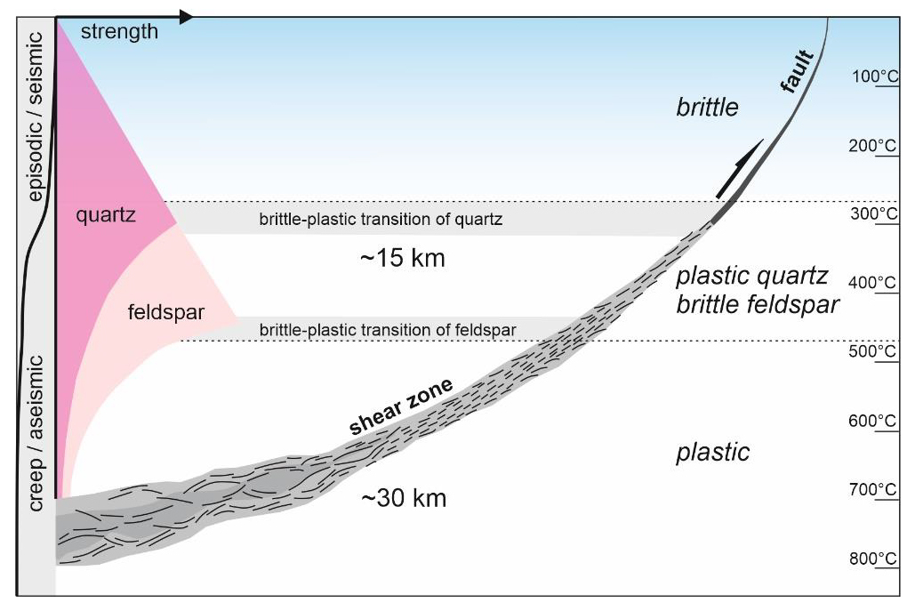
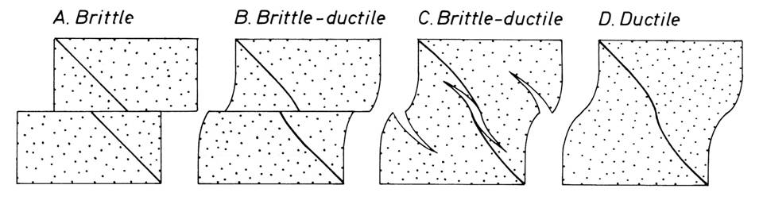
Brittle, semi-brittle, and ductile shear zones
The mechanical properties of rocks change with temperature and pressure, and so the character of localized deformation zones changes with depth
In the brittle upper crust, shear zones include faults and deformation bands
At greater depths, where rocks flow rather than fracture, these zones of deformation are described as ductile shear zones
In the transition between brittle and ductile behaviour, shear zones have a mixed, semi-brittle character, and are associated with en échelon arrays of extension cracks
Notes:
The change in the way that rocks deform with the deformation conditions is described in the Optional PowerPoint presentation
Strictly, a ductile shear zone is one in which some marker layer can be traced continuously across the shear zone, although if the displacements are large, this might only be true in principle rather than in actuality
Figure top from Fossen & Cavalcante, 2017, Earth-Science Reviews 171: 434-455, http://dx.doi.org/10.1016/j.earscirev.2017.05.002
Figure bottom from Ramsay & Huber vol. 2, p.596

Slide 4
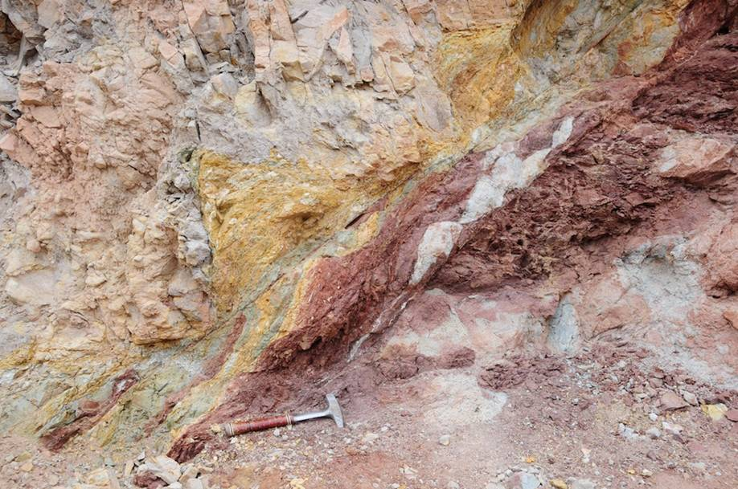
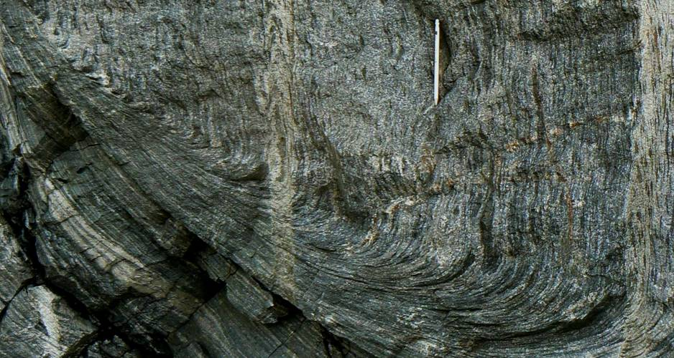
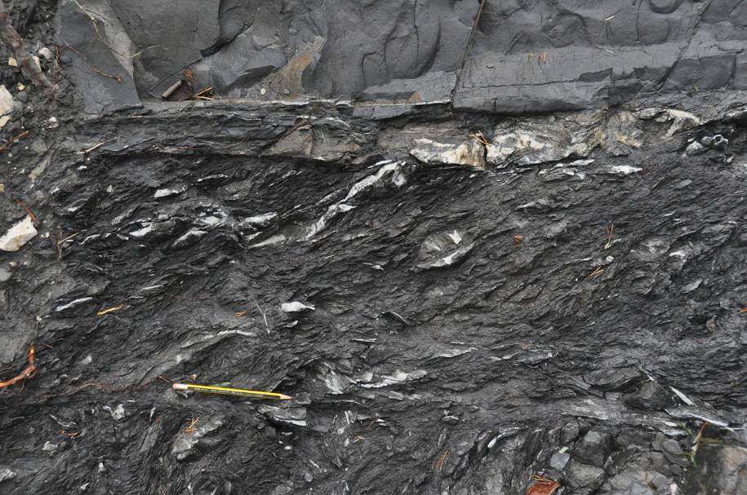
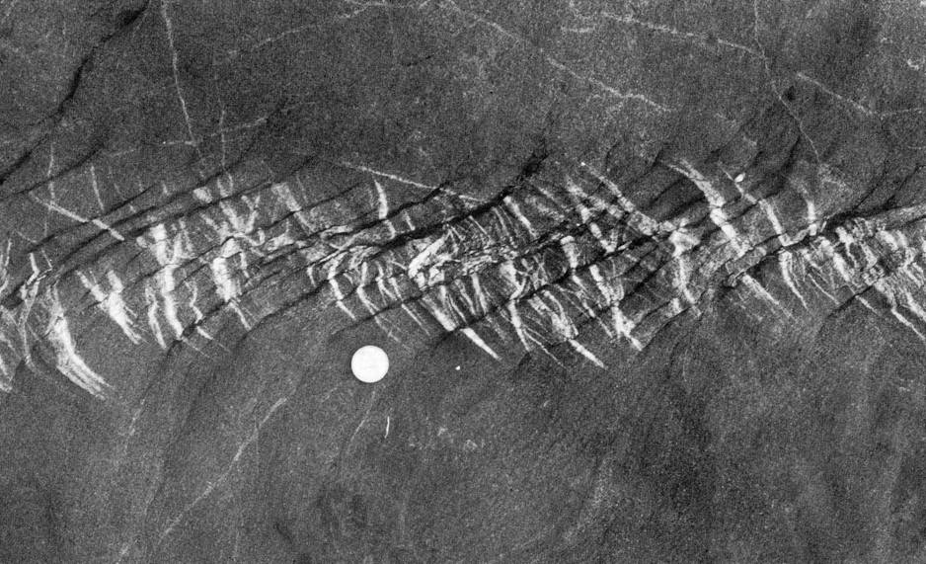
Brittle, semi-brittle, and ductile shear zones
Brittle (left), ductile (above), semi-brittle (below)
Notes:
Photo top left (Fossen, one of the extra figures on the web-site for the book, folk.uib.no/nglhe/StructuralGeoBook.html): brittle shear zone, Moab Fault, Utah
Photo top right (from mentemalleo.wordpress.com/tag/metamorphism): amphibolite facies ductile shear zone, Norwegian Caledonides near Bergen
Photo bottom left (Steve Covey-Crump): semi-brittle shear zone from Les Sauzeries Formation below Le Château, Barrême Basin, France
Photo bottom right (from Price & Cosgrove, 1990, Analysis of Geological Structures, p.471): semi-brittle shear zone from Marloes Sands, Pembrokeshire. The quartz veins infill extension cracks; the other fabric at about 90° to the veins is a pressure solution cleavage

Slide 5
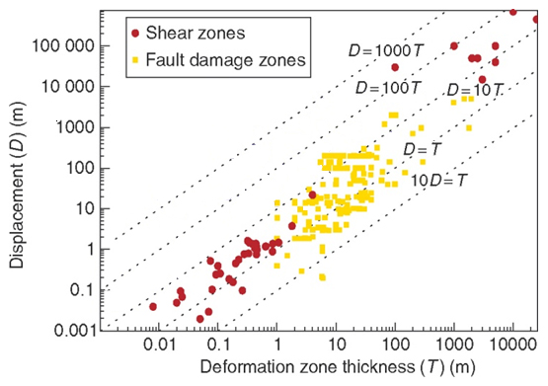
Description of shear zones
A shear zone is bounded by two margins (shear zone walls) that separate relatively undeformed rock lying outside the zone from more strongly deformed rock inside it. As surfaces, the orientation of these shear zone walls should be specified as strike/dip
Once the margins of the shear zone have been defined, its thickness may be measured, and sometimes the displacement across it. Shear zone thickness tends to increase with displacement
Even if the magnitude of the displacement is unknown, the geometry of the rock fabrics within the shear zone usually allow the sense of displacement (normal/reverse; sinistral/dextral) to be determined
Relationship between displacement and thickness for ductile shear zones (red) and fault zones (yellow)
Notes:
As we shall repeatedly note when we consider faults in the forthcoming classes, the key things that need to be stated when describing shear zones and faults are
The orientation (strike/dip) of the shear zone walls
The orientation (plunge/plunge direction) of the slip vector
The magnitude and sense of displacement of the strike-slip and dip-slip components of the slip vector
On this slide, ‘displacement’ means ‘slip-vector’. For shear zones it is also useful to describe the thickness (width) of the shear zone
Figure from Fossen, p.331 (modified by Steve Covey-Crump). Note that for relatively small displacements (up to ~100 m), the general trend is that displacement (D) is approximately equal to deformation zone width (T), but note also that there is a large scatter (this is a log-log plot) and so the relationship is not particularly helpful as a means of assessing displacement

Slide 6
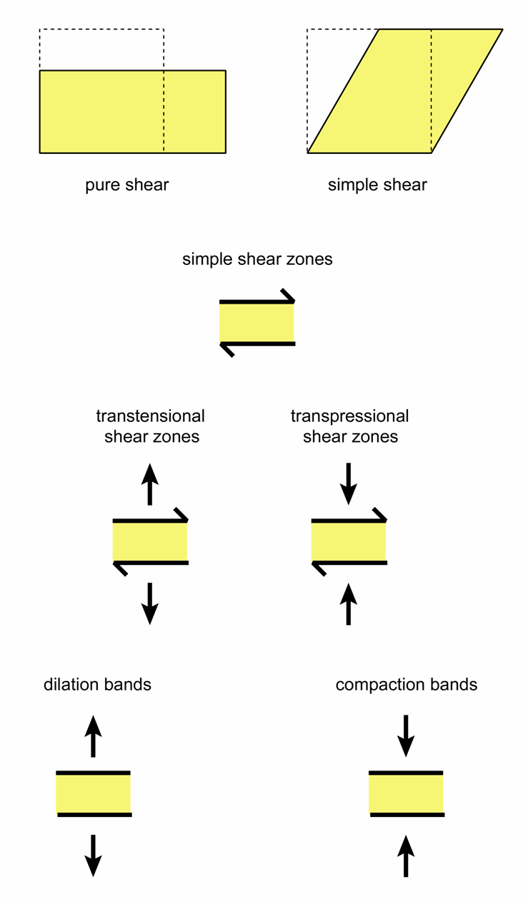
Kinematic classification of shear zones
Shear zones are classified using the relative movement between the two shear zone walls
This relative movement is some combination of
  pure shear
  simple shear
  volume change
In low porosity rocks shear zones are often idealized as simple shear zones but real shear zones may simultaneously involve significant components of extension (transtension) or contraction (transpression) normal to their margins
In high porosity rocks (e.g., some sandstones) the term bands is used for localized deformation zones – in these deformation bands the full range of compaction, dilation, and simple shear deformation may occur
Notes:
Figure by Steve Covey-Crump

Slide 7
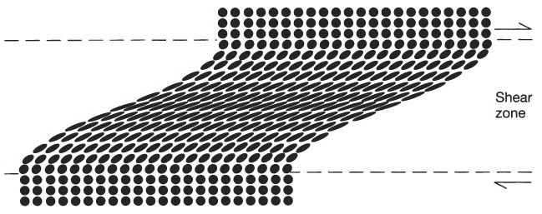
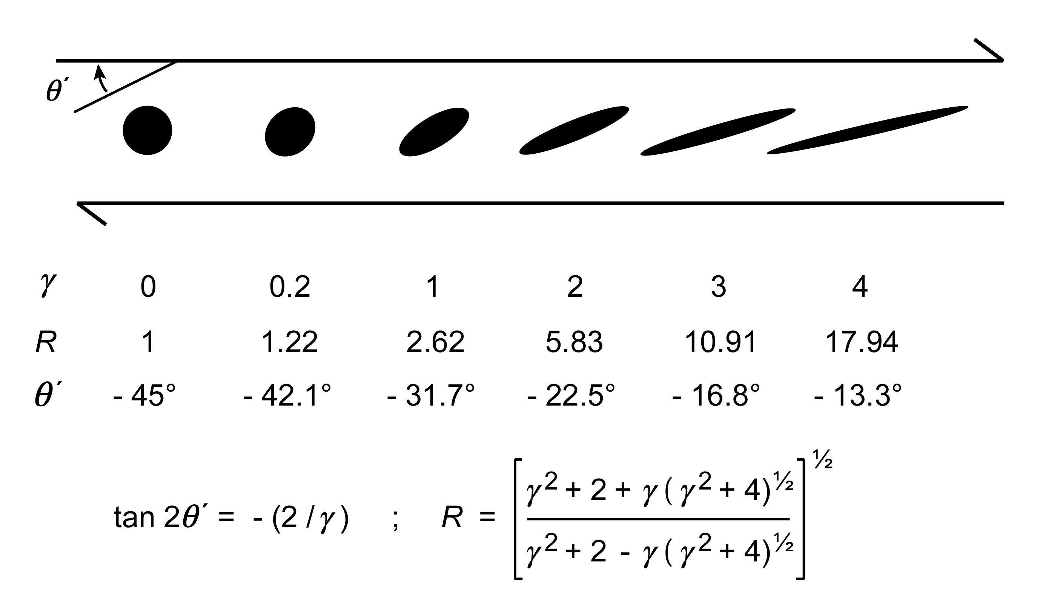
Ideal shear zones formed by progressive simple shear
The simplest model of shear zone deformation is progressive simple shear (most of the comments in this class are based on this model)
Across a progressive simple shear zone, the strain is heterogeneously distributed, varying from zero at the shear zone boundaries to a maximum in the middle of the zone
In the first small increment of strain, the orientation of the maximum extension direction is at 45° to the shear zone wall; with increasing strain it rotates towards parallelism with the shear zone walls without ever becoming exactly parallel
γ = shear strain; R = aspect ratio of the strain ellipse; θ´ = angle between the maximum extension direction and the shear zone wall
Notes:
Figure left from Twiss & Moores, 2007, Structural Geology (2nd edition), p.444
Figure right by Steve Covey-Crump showing the change in orientation of the maximum extension direction (θ´) and strain ellipse aspect ratio (R) with increasing shear strain. The calculations apply for simple shear only – any component of pure shear or volume change modifies the equations. The equation for θ´ is derived from Eqn. 2.4 of Ramsay & Huber, vol.1, and that for R is derived from Eqn. 2.7 of Ramsay & Huber, vol.1. Note that the values of θ´ are negative (clockwise angle) in a dextral shear zone; they are positive in a sinistral shear zone. γ is engineering shear strain (γ = tan ψ; see Class 3 Slide 4)

Slide 8
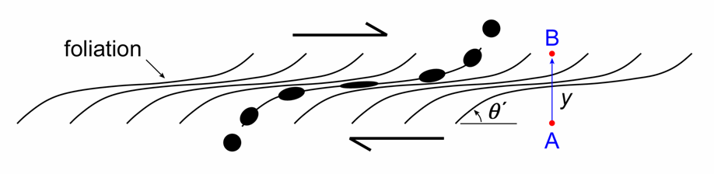
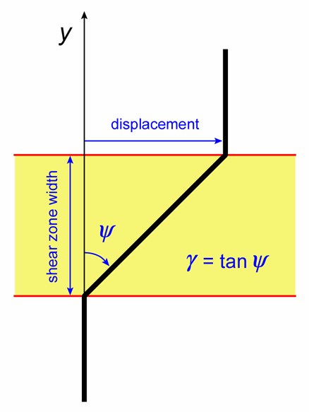
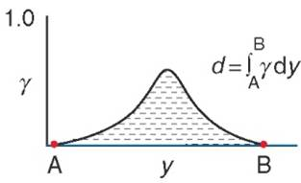
Estimating displacements across shear zones
If the orientation of the long axis of the strain ellipse (θ´) is known at several places across a shear zone, then assuming simple shear, the shear strain at these places may be calculated. The displacement across the shear zone is then the area under a curve of shear strain vs. distance across the shear zone normal to the shear zone walls
The assumption of simple shear may be checked by showing that the aspect ratios (R) of the strain ellipses given by strain markers are as predicted by simple shear
displacement
γ =
width
Notes:
From the orientation of the long axis of the strain ellipse θ´ then the tan 2θ´ formula on the bottom right figure may be used to determine the shear strain γ. The equation written in yellow on the slide simply expresses the usual trigonometrical relationship, tan θ = opposite over adjacent (see the diagram bottom left, where θ is ψ). Hence, we see that “displacement = γ × shear zone width”. In the figure bottom left γ is constant across the shear zone, but if instead it varies across the shear zone, then the “displacement = γ × shear zone width” equation becomes the integration that yields the area under the “shear strain vs. distance across the shear zone curve”
The cross-check that simple shear applies makes use of the formula for R (the aspect ratio of the strain ellipse) on the bottom right figure – the calculated value of R from the γ values determined from the measured θ´ may be compared with the measured values of R
For further details on this technique, see Ramsay and Huber, vol.1, Questions 3.4 and 3.5 (p.37ff.). Note that looking at the diagrams on the slide it is tempting to think that θ´ = 90 - ψ but this is NOT correct – θ´ records the direction of maximum extension while ψ records the change in angle between two lines that were originally orthogonal
You may be able to employ this technique in fieldwork, but you do need a section through the shear zone that contains the slip vector (the XZ plane). The orientation of a foliation produced by the shearing can be used to give the orientation of the maximum extension direction = long axis of the strain ellipse = X direction (see Slide 12)
Figures top left, bottom left, and bottom right by Steve Covey-Crump
Figure bottom middle from Fossen, p.334

Slide 9
Ductile shear zones

Slide 10
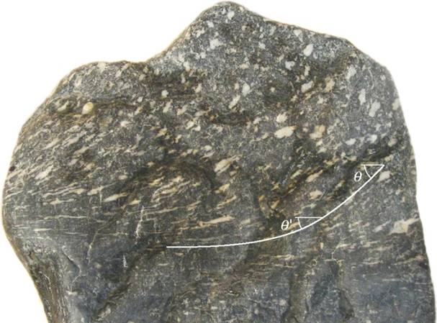
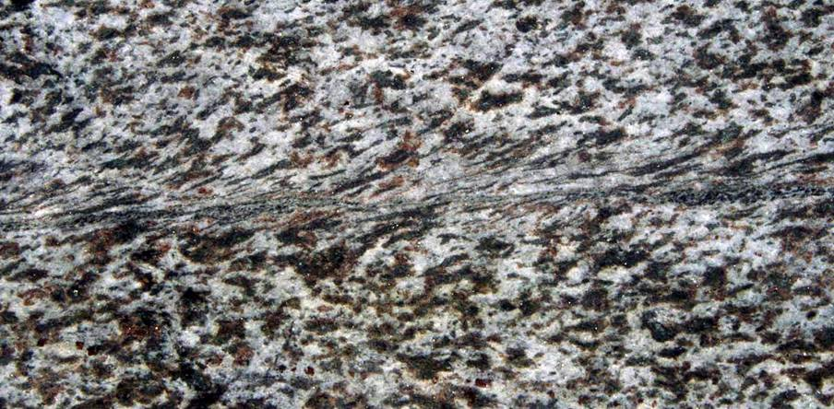
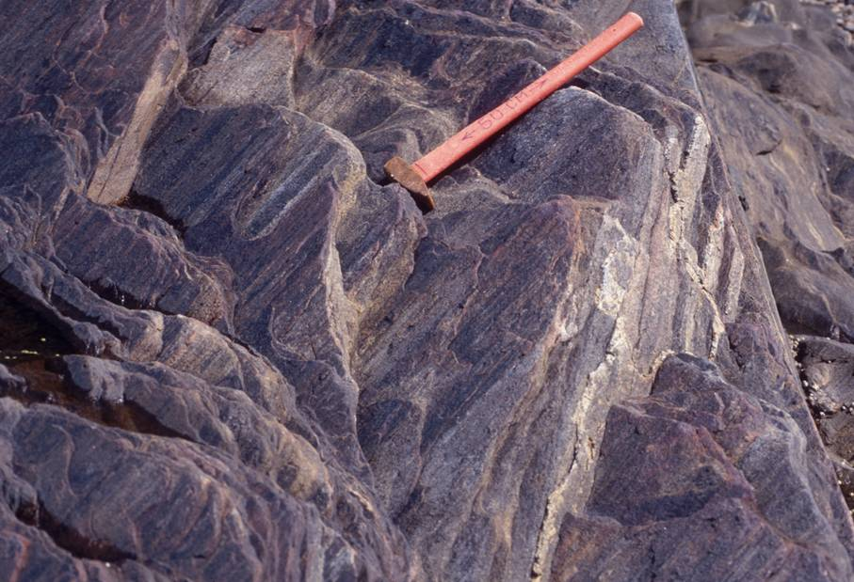
Shear zone rocks (fabrics)
As strain accumulates in ductile shear zones formed at greenschist metamorphic grade and above, a foliation appears, and commonly within it, also a stretching lineation
Objects within the protolith are stretched and rotated into the shear zone, and the fabric is intensified in the centre of the shear zone
The curvature of the foliation provides a very useful indication of shear sense, but to be used in this way the foliation must be one formed during the shearing rather than a deflected pre-existing foliation
Notes:
When using the curvature of foliations to infer slip sense, be aware that how this curvature appears depends upon the orientation of the section through the rock (relative to the shear plane) on which the fabric is being viewed – care is required
Photo top left (from Fossen, p.334): ductile shear zone in a greenstone – the white patches are feldspar aggregates (amygdales)
Photo top right (by Keith Klepeis, badger.uvm.edu/jspui/handle/2051/4185): ductile shear zone, Pembroke Valley, Fiordland, New Zealand
Photo bottom right (by Keith Klepeis: badger.uvm.edu/xmlui/handle/2051/3277): a well-developed stretching lineation within a shear zone (unknown location)

Slide 11
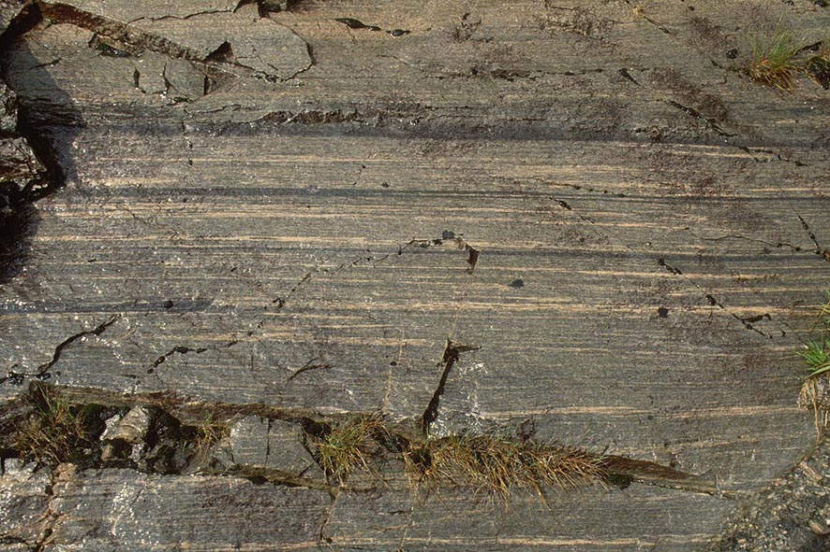
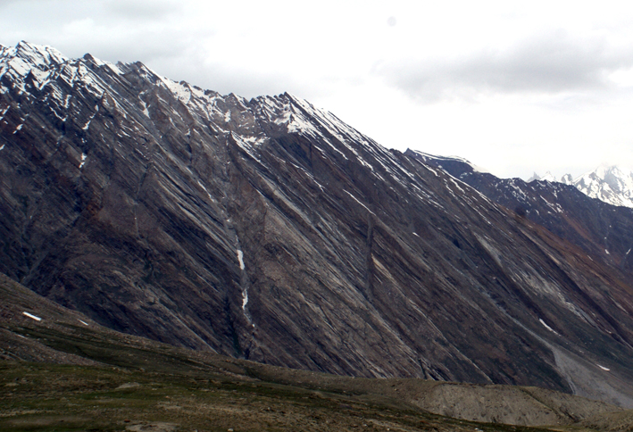
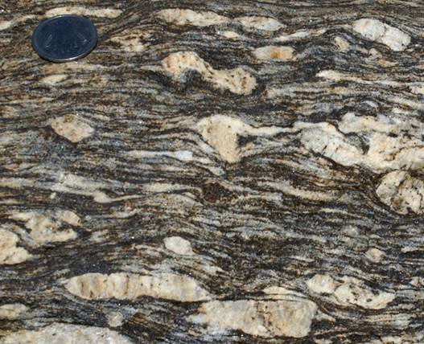
Shear zone rocks (mylonites)
In the middle of a shear zone, the strain may be so large that pre-existing textures are completely transposed. The resulting banded rock is described as a mylonite
Formally, mylonites are fault rocks containing a well-developed foliation that arises during tectonic grain size reduction
Mylonite zones can be up to several kilometres thick and may contain a rich variety of deformation features that are indicative of local variations in finite strain
Notes:
Mylonites are formally defined as “A fault rock which is cohesive and characterised by a well-developed schistosity resulting from tectonic reduction of grain size and commonly containing rounded porphyroclasts and lithic fragments of similar composition to minerals in the matrix”. They are subdivided according to the proportion of original grains that remain unrecrystallized: (1) protomylonites – less than 50% new recrystallized grains; (2) (meso)mylonites – 50-90% new recrystallized grains; (3) ultramylonites – more than 90% new recrystallized grains. For formal definitions, see Brodie et al., 2007, in: Metamorphic Rocks: a Classification and Glossary of Terms (editors D. Fettes & J. Desmonds), p.24-31. There are additional categories: an augen mylonite contains distinctive large crystals around which the foliated matrix is wrapped, and a blastomylonite is a mylonite that has undergone significant grain growth during or after deformation
Photo top left (Fossen, one of the extra figures on the web-site for the book, folk.uib.no/nglhe/StructuralGeoBook.html): Proterozoic migmatite, mylonitized during Caledonian deformation
Photo top right (by Roberto Weinberg, users.monash.edu.au/~weinberg/Pages/Zanskar_SZ/Zanskar_SZ.htm): the thick mylonites of the Zanskar Shear Zone, to the west of Pensi La, Reru Valley, High Himalaya
Photo bottom left (by Roberto Weinberg, users.monash.edu.au/~weinberg/Pages/Reru_valley/Reru_def_melt.htm): porphyroblastic mylonite (granitic protolith), Reru Valley, Zanskar Shear Zone, High Himalaya

Slide 12
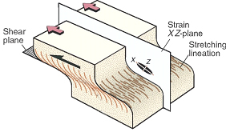
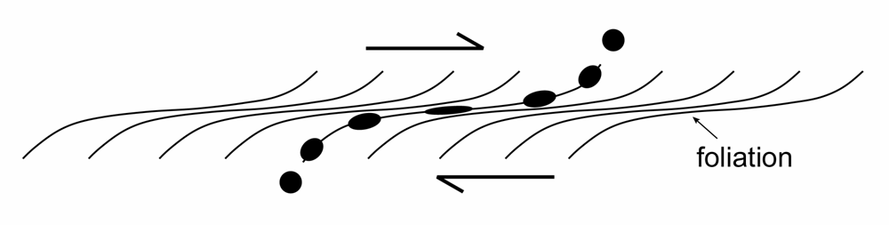
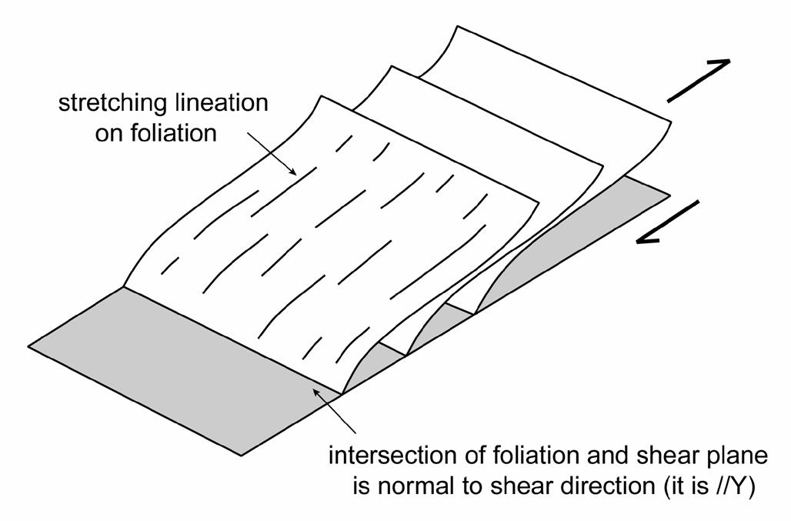
Relationship of shear zone fabrics to finite strain
The foliation tracks the principal flattening plane (XY plane) across the shear zone
XZ plane
Hence in shear zones formed by progressive simple shear:
the foliation is at ~45° to the shear zone walls at the margins and rotates towards parallelism with those walls in the centre of the shear zone
the stretching lineation is parallel to the maximum extension direction
(X direction)
Notes:
Recall the terminology from Class 3: the principal flattening plane is the plane at right angles to the Z axis of the strain ellipsoid (Z = the shortest axis). Hence if Z is at right angles to this plane, that plane contains the longest (X) and intermediate (Y) axes of the strain ellipsoid, that is, it is the XY plane
At the margins of a shear zone the foliation is commonly found to be a little less than 45° because a small amount of strain is required before the foliation is sufficiently well developed to be visible
Figure top left from Fossen, p.342
Figure top right by Steve Covey-Crump
Figure bottom right redrawn and adapted by Steve Covey-Crump from an original by Ernie Rutter

Slide 13
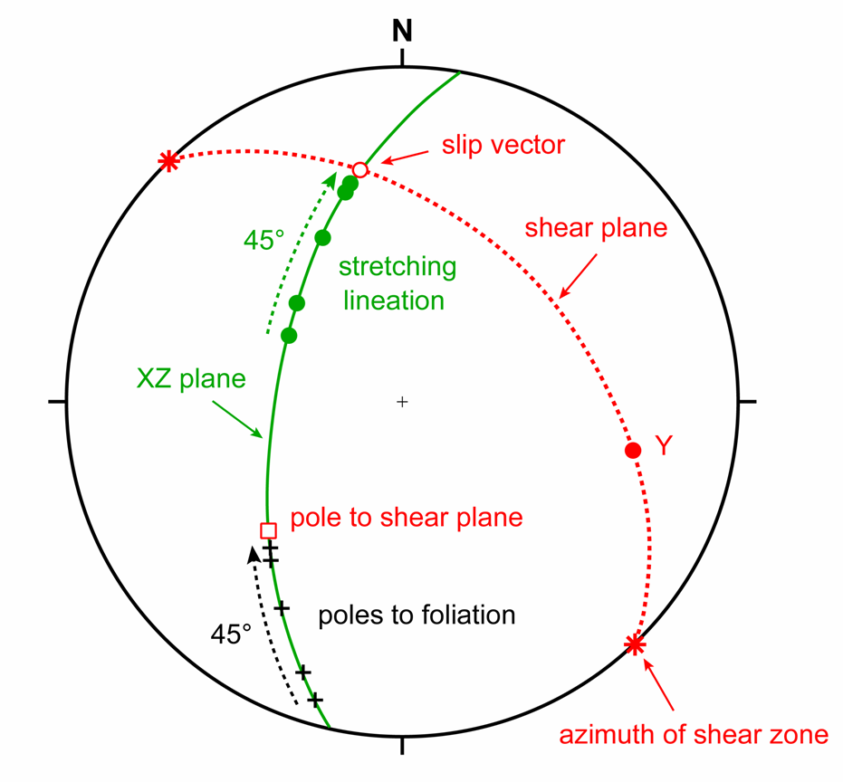
Shear zone fabrics (stereograms)
This geometry implies that on a stereogram:
across the shear zone, the stretching lineation (X) and poles to the foliation (Z) should be spread along the same great circle (XZ plane)
the stretching lineation should reorient towards the slip vector as one moves towards the centre of the shear zone (stretching lineations are usually only seen near the centre of the shear zone)
the pole to the foliation should reorient towards the pole of the shear plane as one moves towards the centre of the shear zone
the pole of the XZ plane (= Y) should lie in the shear plane
Notes:
Hence some or all this information may be used to establish the orientation of the shear zone and the slip vector within it. These matters are so useful that we’ll devote time within the practicals to exploring them
There are other helpful features derivative from these relationships, e.g., the intersection of the foliation plane (measured anywhere in the shear zone) with the shear plane is parallel to Y and therefore at 90° to the slip vector as measured in the shear plane (see figure bottom right on previous slide), and so if one has some approximate idea of the strike/dip of the shear plane, an approximate idea of the slip vector orientation can be obtained from a foliation measurement
Figure top from Fossen, p.342
Figure bottom by Steve Covey-Crump

Slide 14
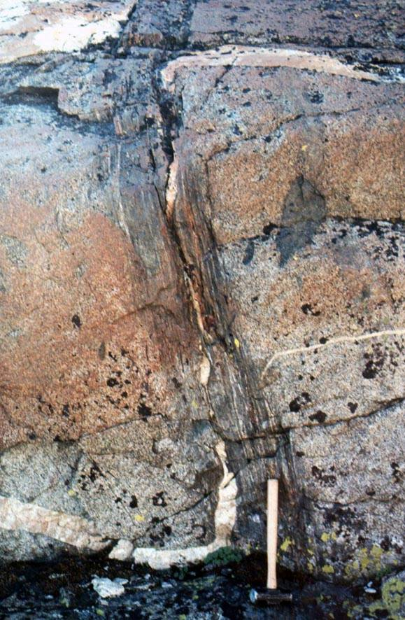
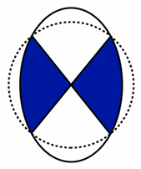
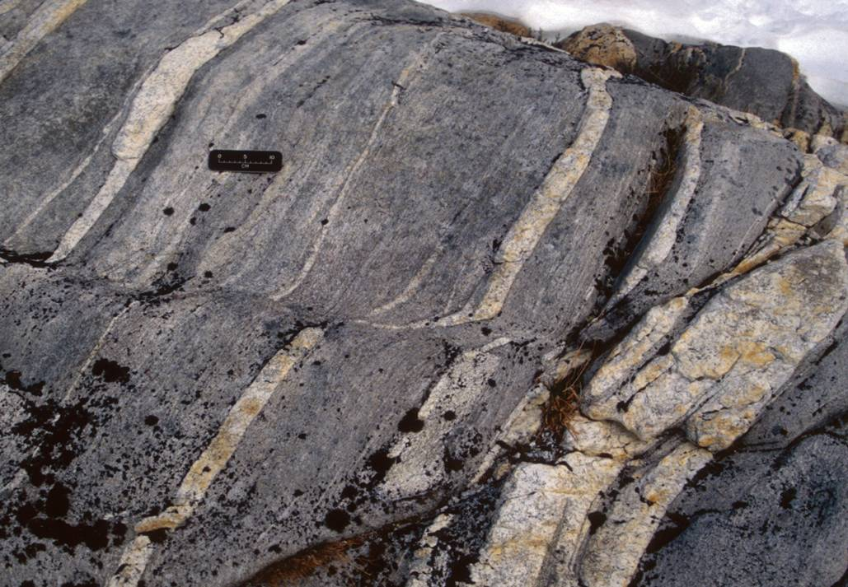
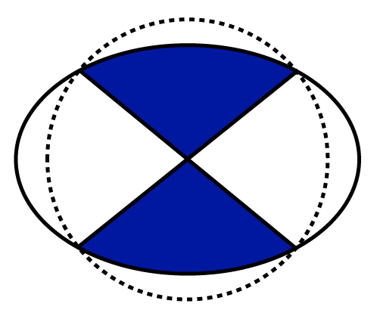
Deflection and extension of markers
Deflected markers across shear zones offer insight into the shear sense, provided that the usual precautions about inferring slip sense from apparent offsets are taken
The obliquity of the incremental strain ellipse to the shear zone margins means that layers crossing the shear zone close to the maximum extension direction should be stretched/boudinaged
Notes:
The caution about using apparent offsets is because the apparent offset of a layer across a fault depends upon (a) the orientation of that layer relative to the fault plane, and (b) the orientation of the surface of observation relative to the fault plane
Photo left (by Keith Klepeis: badger.uvm.edu/xmlui/handle/2051/3299): ductile shear zone (unknown locality). Note that the vein is extended and thinned as it crosses the shear zone
Photo right (Fossen, one of the extra figures on the web-site for the book, folk.uib.no/nglhe/StructuralGeoBook.html): shear zone in a granite, Sierra Nevada. Note that the vein is boudinaged as it crosses the shear zone

Slide 15
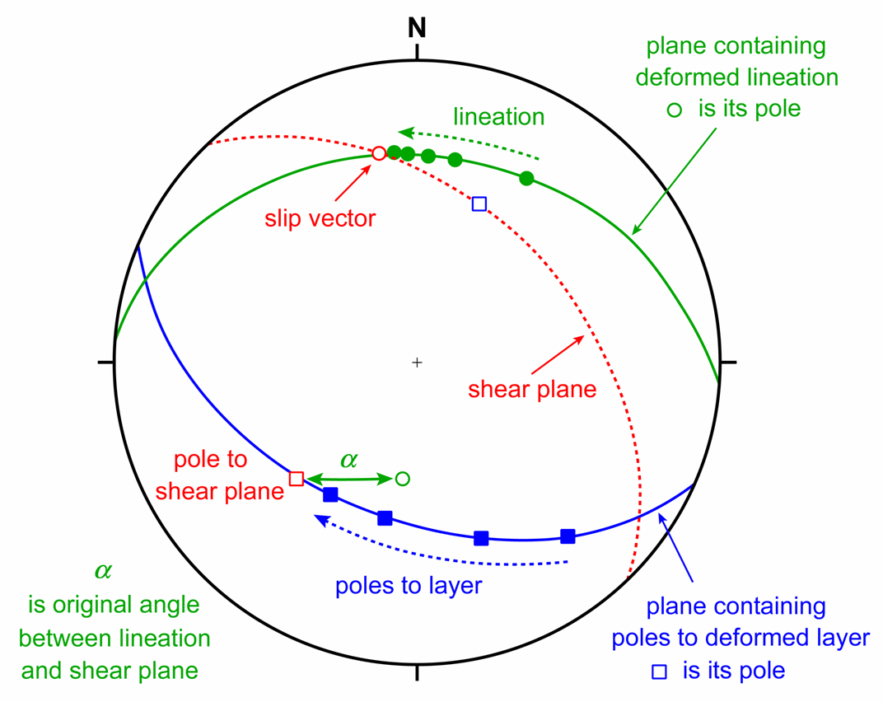
Analysis of lines/planes deformed into a shear zone
Pre-existing lineations and planar features that are rotated into a shear zone may be used to determine the orientation of the shear plane and slip vector
On a stereogram, as one moves into a shear zone:
the orientations of a pre-existing lineation are spread along a great circle towards the slip vector; the intersection of this great circle with the great circle describing the shear plane is the orientation of the slip vector
the poles of a pre-existing planar feature (e.g., a dyke margin) are spread along a great circle towards the pole to the shear plane; the pole of that great circle (fold axis) lies in the shear plane
Notes:
These points will be explored further in practicals to come later in the course. For a diagram illustrating why point (1) is true, see the shear folding figures (Class 2 Slide 30)
Figure by Steve Covey-Crump

Slide 16
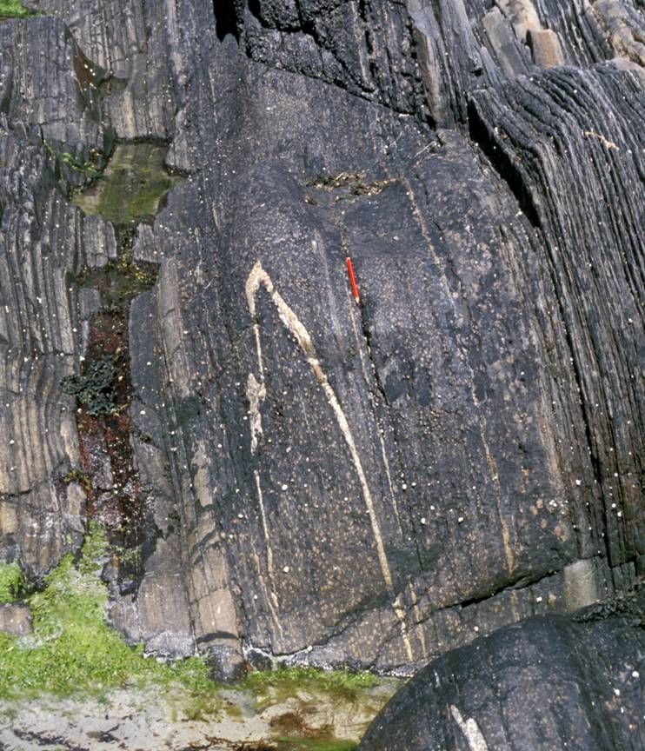
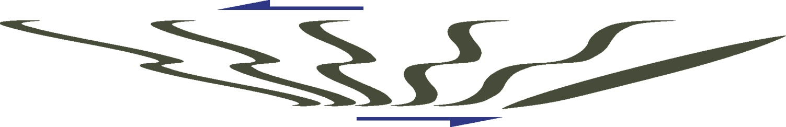
Folded markers
Markers oriented close to the maximum shortening direction of the incremental strain ellipse fold as they cross the shear zone. However, with increasing shear, these folded markers may rotate into an extensional field of the incremental strain ellipse and then start to stretch
Markers passively folded in this way have Class 2 (similar) geometry with thickened hinges and attenuated limbs
The folds may be asymmetric, but care is required when inferring shear sense from their vergence
initial
vergence to right
vergence to left
Notes:
Recall (from Class 2) that markers will deform passively if their competence contrast with the host rock is small; if a significant viscosity contrast exists then they will fold by buckling
Figure bottom adapted from Fossen, p.347
Photo right (Steve Covey-Crump): quartz vein crossing a near vertical, metamorphosed dyke that has been highly sheared, Moine units, Ross of Mull, Scotland. In this case (not that you can tell from the photo), there was almost certainly significant layer-normal contraction and up/down dip extension in addition to the shearing

Slide 17
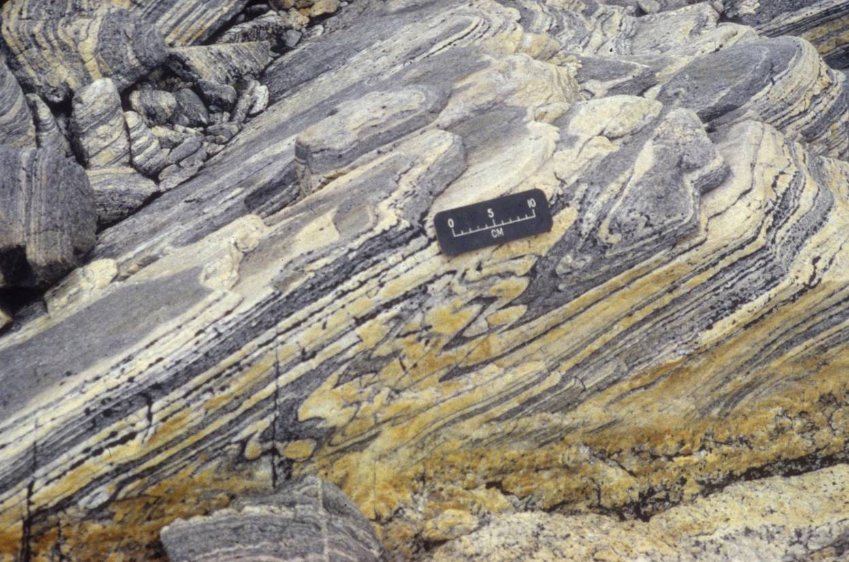
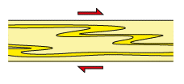
Intrafolial folds
In mylonitic shear zones often the foliation is itself folded. These folds are commonly isoclinal with axial planes in orientations that are indistinguishable from the main mylonitic foliation. Such folds are described as intrafolial folds
Folding of this kind results from local distortions in the flow field during shearing
When viewed in the XZ plane the asymmetry of the folds indicates the sense of shearing
Note the importance of looking in the XZ plane
Notes:
Recall (Class 1 Slide 17) that isoclinal folds are folds with a very small interlimb angle
When the strains are large and any layering crossing the shear zone has been rotated into parallelism with it, the term “intrafolial fold” is often loosely applied to the folded layering as well as to the folded foliation
Figure right from Trouw et al., 2009, Atlas of Mylonites and Related Microstructures, p.211
Photo (by Keith Klepeis: badger.uvm.edu/xmlui/handle/2051/3254): intrafolial folds (unknown location). It looks to me that there might be a stretching lineation oriented approximately in the dip direction of the foliation. The asymmetry of the folds suggests up-dip (dextral) shear sense (compare with the figure right)

Slide 18
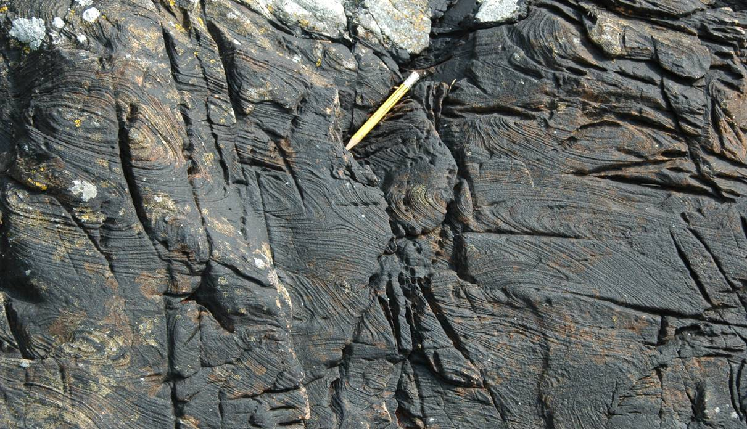
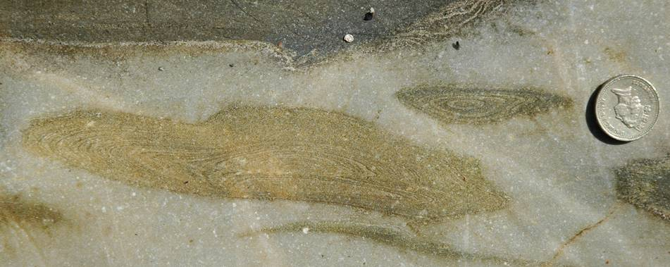
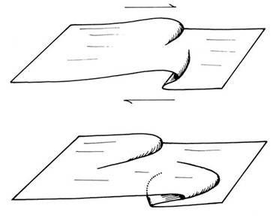
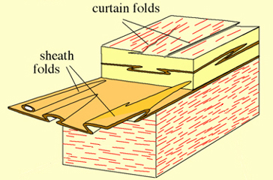
Sheath folds
Some intrafolial folds may amplify into tubular shapes with hinge lines that swing into parallelism with the X direction as strain increases. These are described as sheath folds
Folds with hinges that are parallel with the X direction, but which are not tubular are called curtain folds
XY
XZ
YZ
In the YZ plane, sheath folds have a characteristic ‘eye’ shape
Notes:
Figure bottom left from Price & Cosgrove, 1990, Analysis of Geological Structures, p.268. For further photos of sheath folds, see Class 2 Slide 33
Figure bottom middle from Passchier & Trouw, Fig.5.10a
Photos (Steve Covey-Crump): sections through sheath folds in carbonate layers within the coastal section at Onich, Scotland

Slide 19
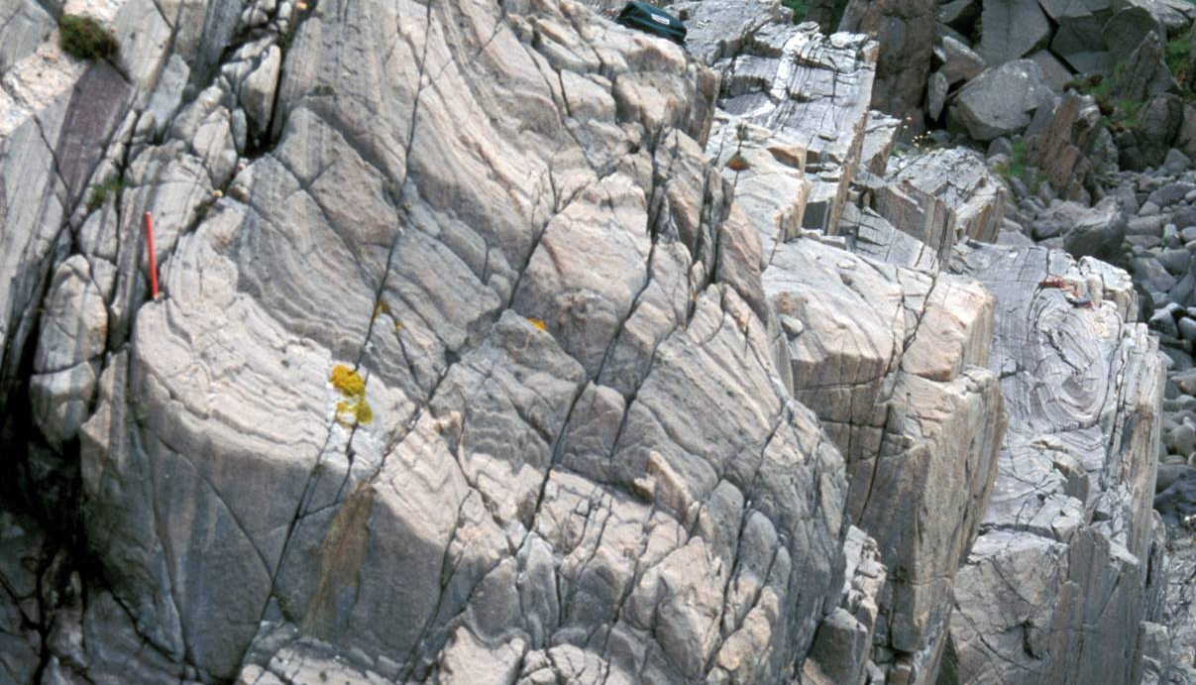
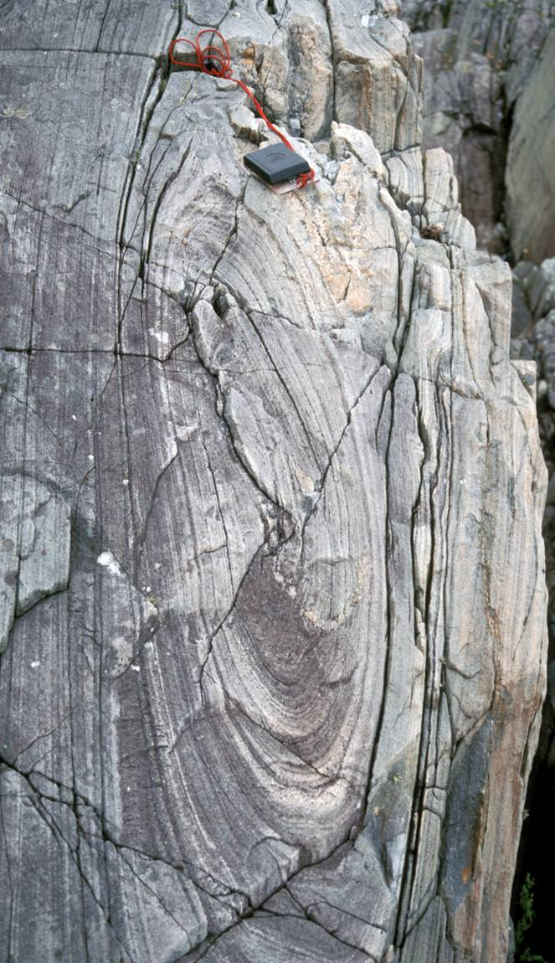
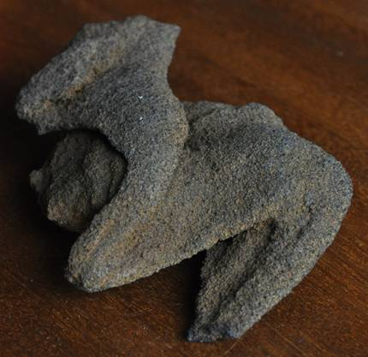
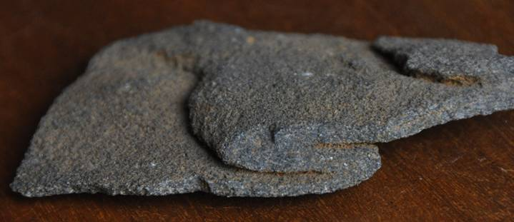
Sheath folds
The central axis of this sheath fold (note the fold axis under the pencil) is parallel to a stretching lineation
Hand specimen examples
Notes:
Photos top left and right (Steve Covey-Crump): a sheath fold in the Moine metasedimentary units, Ross of Mull, Scotland – the photo to the right is an enlargement of the eye-shaped fold that can be seen on the right-hand side of the photo on the left
Photos bottom left and middle (Steve Covey-Crump): sheath folds in a ferruginous sandstone, northern Spain. In the example on the left, the fold hinge is only slightly curved but in the example in the middle the hinges are strongly curvilinear

Slide 20
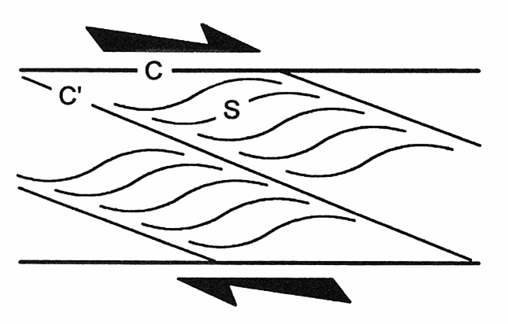
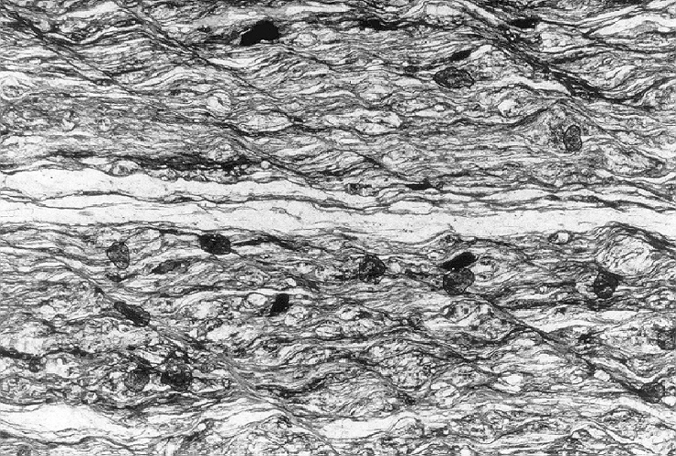
S-C fabrics
As strain increases, a set of shear bands (C - surfaces) forms parallel to the shear zone walls. These deflect the main foliation (S - surface) in the same sense as the shear sense
With further increase in strain, the angle between the C and S surfaces becomes very small, and a new set of shear bands (C´- surfaces) forms at 15-35° to the shear zone walls
Across the C´- surfaces the sense of deflection of the main foliation is extensional, and in the same general direction as the shear sense (= extensional crenulation cleavage)
S
C´
Notes:
The C´-surfaces are in the same orientation as Riedel shears in clay-bearing fault gouges (see Slide 45). Their extensional character means that they are commonly described as extensional crenulation cleavages
The distinction between C- and C´-surfaces is often not made in the literature
Figure top redrawn by Steve Covey-Crump from Blenkinsop, 2000, Deformation Microstructures and Mechanisms in Minerals and Rocks, p.72
Photomicrograph bottom (from Passchier & Trouw, Fig.5.15): mica-schist, Menderes Massif, Turkey (width of view = 3.5 mm), sectioned parallel to the XZ plane

Slide 21
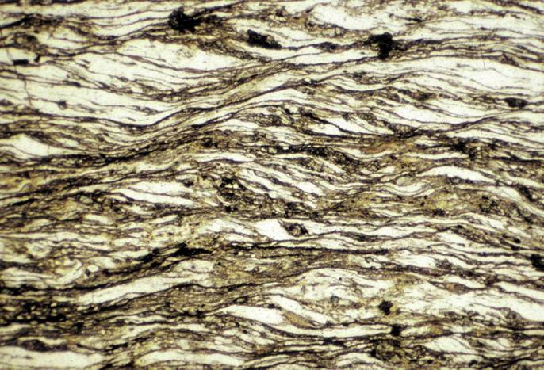
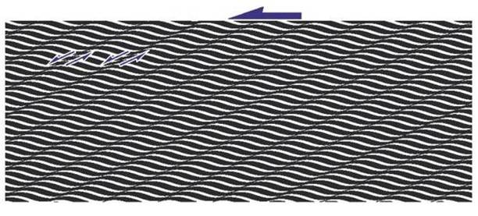
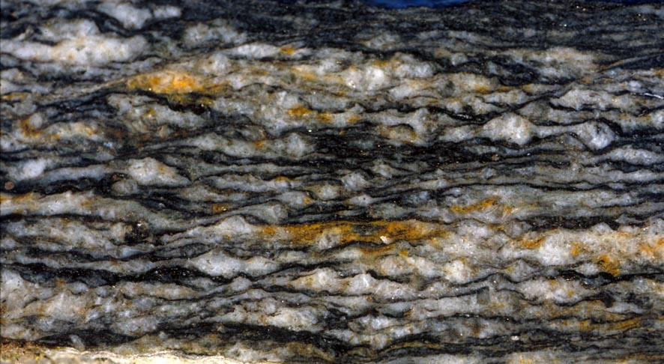
S-C fabrics (further examples)
Shear zone rocks with these fabrics are described as S - C mylonites – these fabrics, particularly the C´ surfaces, make superb shear sense indicators
C surfaces are indicative of inhomogeneous simple shear; they can develop early in the deformation and are often straight and continuous
C´ surfaces tend to develop late in the deformation and are commonly short, wavy and anastomosing
C´
S
Notes:
My terms “early” and “late” on the slide refer to early and late in the evolution of the mylonitic fabric. The origin of C´ surfaces is only partly understood. They form after a strong mineral preferred orientation has been established and probably represent an energetically favourable flow partitioning in systems that are composed of strongly anisotropic minerals (see discussion on S-C mylonites in Passchier & Trouw, p.128-132)
Figure from Fossen, p.295
Photo top right (from John Platt’s lecture notes on microstructure and rock rheology): micaceous mylonite from southern Spain. C and C´-surfaces are best developed in micaceous lithologies
Photo bottom (Fossen, one of the extra figures on the web-site for the book, folk.uib.no/nglhe/StructuralGeoBook.html): sheared granite, Norwegian Caledonides at Evanger, north-east of Bergen

Slide 22
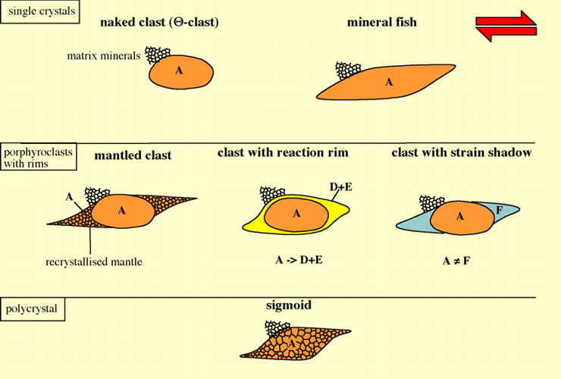
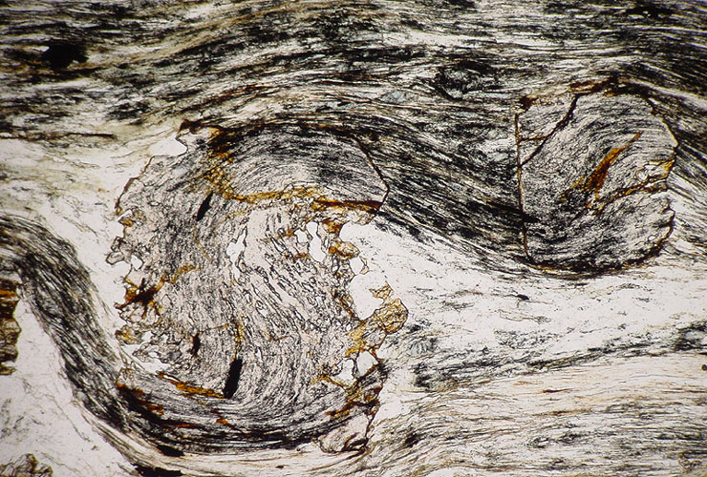
Shear sense from objects within mylonites
A number of objects found within the matrix of mylonites, together with the deflections of the foliation around these objects, provide excellent shear sense indicators
Six types of object are particularly helpful. It is good practice when making observations to note which of these six types is being considered because although their geometry for shear sense evaluation is similar, they each form by a different mechanism
The use of sigmoidal inclusion trails in syntectonic porphyroblasts as shear sense indicators is problematic. Establishing whether they have formed by porphyroblast rotation, matrix deformation around the porphyroblast, or some other mechanism is non-trivial (see Passchier & Trouw, Fig. 7.34 in § 7.6.8)
Notes:
NOTE: porphyroblasts grow in response to changing metamorphic conditions; porphyroclasts are the remnants of grains within an originally coarse-grained rock
Types of object:
Naked clasts/mineral fish have no rims
Mineral fish are lozenge-shaped
In a mantled porphyroclast the rim is made of the same mineral as the clast
In the other two types of rimmed porphyroclast the rim contains different minerals to the clast
Sigmoids are polycrystalline aggregates of a mineral with the shape indicated in the figure top right
For those of you who are not taking Metamorphic Minerals and Processes, there are some helpful comments on using inclusion trails within porphyroblasts to infer the timing of deformation and porphyroblast growth on https://www.alexstrekeisen.it/english/meta/porphyroblastic.php. When those inclusion trails are sigmoidal, porphyroblast growth could be interpreted as occurring at the same time as the deformation (that is, that it was syntectonic), and it may be possible to infer the sense of shear. For example, in the photomicrograph at bottom right of this slide, the sigmoidal inclusion trails suggest that the garnet was rotating anticlockwise as it was growing (sinistral sense of shear implied)
As an example of some of the issues associated with using porphyroblasts with sigmoidal inclusion trails as shear sense indicators, see Williams & Schoneveld, 1981, Tectonophysics 78: 307-334, https://doi.org/10.1016/0040-1951(81)90019-6
Figure top from Passchier & Trouw, Fig.5.20
Photomicrograph bottom (from Passchier & Trouw, Exercise 20a): garnet porphyroblasts in a garnet-chloritoid-muscovite schist, Itumirim, Minas Gerais, Brazil (width of view 2 mm)

Slide 23
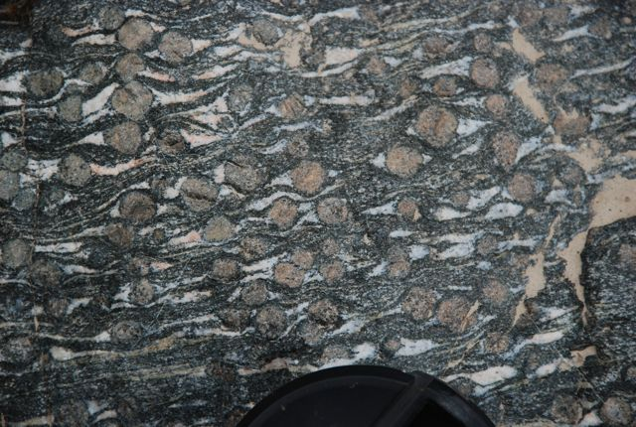

Mantled porphyroclasts
Mantled porphyroclasts consist of a central single crystal with a fine-grained mantle of the same mineral. The mantle may be drawn out into wings that stretch and change shape while the core remains rigid
Viewed in the YZ plane the wings are symmetric (ϕ - type) and so cannot be used to infer the sense of movement
Symmetric wings: note that in this case these are not actually mantled clasts but strain fringes (see below) because the rims (quartz) are of a different mineral than the porphyroblasts (garnet). However, the same logic about the sense of movement applies
Notes:
Figure bottom left from Passchier & Trouw, Fig.5.21
Photo (by Chris Mattinson, www.geology.cwu.edu/facstaff/mattinson/2008_photos/): stream polished surface of a garnet amphibolite, Dulan region, North Qaidam ultra-high pressure metamorphic terrane, western China

Slide 24
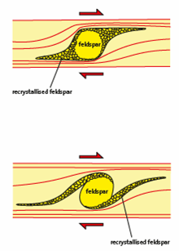



Mantled porphyroclasts (σ - type)
However, viewed in the XZ plane, the wings are asymmetric – two types of asymmetry (σ - type and δ - type) allow shear sense to be inferred
σ-type
δ-type
σ-type
In σ - type porphyroclasts, the observation that the tips of the wings lie at different elevations on either side of the porphyroclast is described as stair-stepping
Notes:
In stair-stepping the sense of shear is obtained if you walk up the stairs
Figure top right from Trouw et al., 2009, Atlas of Mylonites and Related Microstructures, p.159
Photograph left with annotated interpretation next to it (from blogs.agu.org/mountainbeltway/2011/10/27/pavement-outcrops-of-strained-seine-conglomerate/): deformed polymict conglomerates from the boundary between the Wabigoon and Quertico sub-provinces of the Superior Craton, Seine River, Ontario, on the Canada/U.S.A. border. The conglomerate clast in the centre of the image looks like a σ-type porphyroclast although, using the terminology of two slides back, it is not strictly a mantled clast but rather a naked clast
Photomicrograph left (from Passchier & Trouw, Fig.5.23): σ-type porphyroclast (a mantled K-feldspar) in a matrix of recrystallized quartz in a granite mylonite, St. Barthélemy Massif, Pyrenees, France. Width of image 4 mm

Slide 25



Mantled porphyroclasts (δ - type)
σ-type
δ-type
Notes:
Figure top right from Trouw et al., 2009, Atlas of Mylonites and Related Microstructures, p.159
Photo top (from Fossen, p.346): feldspar porphyroclast with wings of recrystallized feldspar, western gneiss region, Finnøy, Norway
Photo bottom left (from Passchier & Trouw, Fig.11.7): a sheared rock analogue – the porphyroclast is camphor and the matrix is octachloropropane. By working with transparent analogue materials, it is possible to watch the development of this microstructure (see Ten Brink & Passchier, 1995, Journal of Structural Geology 17: 131-146, https://doi.org/10.1016/0191-8141(94)E0032-T)
Photo bottom right (by Charles Corrigan: earth-likeplanet.blogspot.co.uk/2011_12_01_archive.html): δ-type porphyroclast from the Parry Sound Shear Zone, Ontario

Slide 26



Sigmoids and quarter structures
Sigmoids have similar geometry to σ - type mantled porphyroclasts but they lack the central rigid clast, perhaps because it has been entirely recrystallized
The way in which the foliation wraps around the porphyroclast may be used to infer shear sense (quarter structures)
Notes:
Quarter structures: the oblique orientation of the incremental strain ellipse to the margins of the shear zone leads to an asymmetry in the way that the foliation rotates around objects within shear zones. In compressional sectors the foliation may thin and intensify, while in extensional sectors it may thicken and fold
Figure top right from Passchier & Trouw (Fig.5.20): cartoon of a sigmoid
Figure left from Fossen, p.347: the relationship of quarter structures to the incremental strain ellipse
Photo bottom right (https://www.jpl.nasa.gov/spaceimages/details.php?id=PIA22942): Juno image (21 Dec 2018) of Oval BA and the Great Red Spot on Jupiter. Oval BA is an anticlockwise rotating massive storm that formed when three smaller spots merged in 2000. In 2005/6 its colour changed from white to the same red as the Great Red Spot but in 2018 its colour changed back to white. Note the quarter structures around the storm. There is an animation of the storm at https://www.jpl.nasa.gov/spaceimages/details.php?id=PIA22943

Slide 27



Strain fringes
The oblique orientation of the incremental strain ellipse to the margins of shear zones may also lead to asymmetry in the development of strain fringes around objects in shear zones because the fringes develop preferentially in the direction of maximum extension
If the strain fringe is fibrous, then the fibres may provide information about the reorientation of the rock relative to the incremental strain ellipse during progressive deformation
Notes:
Figure top right (from Fossen, p.346): rotated garnet (pink) with quartz fringes (blue). Note that quarter structures and shear bands (C´-surfaces) around the porphyroblast support the top-to-the-west shear sense that is implied by the asymmetry of the strain fringes (σ-type). However, the inclusion trails within the porphyroblast seem to suggest that it has been rotated clockwise which would imply the opposite sense of shear. The interpretation of the inclusion trails is the one that we would have less confidence in here (see Slide 22)
Figure bottom left (from Passchier & Trouw, Fig.6.24a): showing the development of fibres during progressive dextral simple shear
Photo bottom right (from Passchier & Trouw, Fig.6.20a): quartz fibres developed around a spherical pyrite framboid in a chert, Yilgarn Craton, Western Australia. Note that a dextral shear sense follows from the orientation of the fibres closest to the pyrite (the latest stages of fibre growth are closest to the pyrite; the earliest formed parts of the fibre are furthest away and have been rotated). Fibrous strain fringes tend to form at rather lower strains and temperatures than those we have been predominantly considering so far

Slide 28




Fractured/boudinaged porphyroclasts
Rigid (competent) objects within shear zones may be fractured and boudinaged
Low angle fractures (C´ orientation): slip synthetic to shear sense; shear-band boudins
High angle fractures: slip antithetic to shear sense with back-rotation; domino boudins
Antithetic ; Synthetic
Notes:
The use of fractures in this way should be with caution – fracture orientation may be partly controlled by the crystallography of the porphyroclasts, and also by factors such as porphyroclast shape that influence the stress distribution within the porphyroclast (we will introduce stress in Class 5)
Figure top left from Fossen, p.346
Figures middle left and bottom left from Passchier & Trouw, Fig.5.43. For domino boudins note that the fragments rotate with the sense of shear (clockwise in this case)
Photo right (from Passchier & Trouw, Fig.5.40): fractured feldspar porphyroclasts in a granite mylonite, St. Barthélemy, Pyrenees, France. Note the antithetic fractures in the porphyroclast top right, and synthetic fractures in the porphyroclast bottom left

Slide 29



Mineral fish
Mineral fish are elongate, lozenge-shaped single crystals mostly lying with their longest dimension at a small angle to the shear plane and stepping up in the direction of shear
The most common mineral fish are white micas
Mica fish may be subdivided into six morphological categories. The relationship of the cleavage to the external form of the crystal is important in coming to a secure interpretation of shear sense
Notes:
Figure left from Passchier & Trouw, Fig.5.28a
Figure top right from Trouw et al., 2009, Atlas of Mylonites and Related Microstructures, p.186
Photomicrograph bottom right (from Passchier & Trouw, Fig.5.18): mica fish between C-type shear bands, mylonitic quartz mica schist, Varginha, Minas Gerais, Brazil

Slide 30


Shape fabric and lattice preferred orientations (LPO)
The foliations in a mylonite may be defined (1) by a preferred orientation of micas, (2) by a mineralogical layering, and/or (3) by a grain shape preferred orientation
The principal foliation (S-surfaces) tracks the orientation of the finite strain ellipse, and so it follows that the grain shape preferred orientation does this too (hence the potential of Fry-type strain analyses)
At the deformation conditions in which ductile shear zones form, the grain shape fabric is usually accompanied by a lattice preferred orientation (LPO) of the individual grains (e.g., an alignment of the crystallographic c-axes)
Shear sense may be inferred from the asymmetry of this LPO
Notes:
Exercise 3 of the Class 3 practical on strain was a Fry strain analysis (see also Class 3 Slide 27)
There is a brief description of how LPOs form in the optional PowerPoint presentation (Slide 31)
Figure bottom left from Fossen, p.344. In this sketch the quartz aggregates are mostly shown as sigmoids with the individual grains within the sigmoids having a strong grain shape fabric
Photomicrograph (from Passchier & Trouw, Fig.5.31): the grain shape fabric (defining an S-surface) implies a top-to-the-right shear sense (as do the Group 1 type mica fish), quartz mylonite, Minas Gerais, Brazil. Width of view 4 mm

Slide 31


Summary: shear sense in ductile shear zones
Notes:
For a rather technical commentary of the use of the various shear sense indicators described on Slides 22-30, see Zhang & Fossen, 2020, Journal of Structural Geology 130, article 103893, https://doi.org/10.1016/j.jsg.2019.103893. The authors suggest that if using mantled porphyroclasts for this purpose then only porphyroclasts that are approximately equant are really reliable, they urge caution in using mica-fish (Slide 29), and they are particularly skeptical about using fractured porphyroclasts (Slide 28). The key point is don’t use shear sense indicators indiscriminately – consider the context in which they occur, and utilize several criteria wherever possible
Figure from Fossen, p.342
Photo (Steve Covey-Crump): hand specimen from unknown location in the DEES collection. Are you happy that the shear sense is top to the left? Note the sigmoids / σ-porphyroclasts, mica fish, and C´-surfaces. Given the cautionary words in the first bullet of these notes, this is a sample that needs to be seen in context to be really confident that this shear sense interpretation is reliable

Slide 32
Semi-brittle shear zones

Slide 33



Combined ductile and brittle deformation
In upper crustal environments, particularly when fluids are present, shear zones commonly show many of the features of ductile deformation that we have been describing (e.g., grain shape fabrics, LPOs, strain fringes) but they also show features indicating brittle deformation (e.g., fractures and veins)
In semi-brittle shear zones the fractures commonly form en échelon arrays
In simple shear, these fractures (tension gashes) form at 45° to the shear zone wall, parallel with the maximum shortening direction of the incremental strain ellipse, and may therefore be used to infer shear sense
Notes:
A helpful paper that attempts to integrate the various mesoscale and microscale deformation features of semi-brittle shear zones is Knipe & White, 1979, Journal of Structural Geology 1: 53-66, https://doi.org/10.1016/0191-8141(79)90021-X. Note that many of the microstructural features require some background knowledge of the microscale processes by which rocks deform (see optional PowerPoint presentation)
Photo top right (from blogs.agu.org/mountainbeltway/2012/04/11/blue-ridge-thrust-fault-field-trip/): S-C mylonites developed, at least partly, under semi-brittle conditions, Blue Ridge thrust, North Virginia
Photo bottom left (Steve Covey-Crump): en échelon tension gash arrays in Carboniferous limestones, West Angle Bay, Pembrokeshire

Slide 34



Tension gash arrays 1
A foliation (pressure solution fabric) may form at ~90° to the tension gashes
With continuing deformation, the veins widen and rotate becoming sigmoidal, and a second generation of veins may develop that transects the initial set
Tension gash arrays may form conjugate sets
Notes:
On the orientation of tension gashes in shear zones, see the left-hand diagram in the bottom left figure. In response to top to the right shearing, the maximum shortening direction is indicated by the two arrows drawn parallel to the veins; the veins open in a direction at right angles to this direction
Four mechanisms have been proposed for the formation of en échelon vein arrays – for a brief summary, see Bons et al., 2012, Journal of Structural Geology 43: 33-62 (p.39), https://doi.org/10.1016/j.jsg.2012.07.005. The development of sigmoidal tension gashes is discussed by Lisle, 2013, Journal of Structural Geology 50: 35-43. https://doi.org/10.1016/j.jsg.2012.08.002. We will consider the mechanics of vein formation in Class 6
Photo right (Steve Covey-Crump): conjugate arrays of tension gashes, Marloes Sands, Pembrokeshire. The sense of shear is indicated. Note also the formation and intensification of a pressure solution cleavage at ~90° to the gashes. Pressure solution is generally an important process in shear zones formed at relatively low metamorphic grades (as discussed further in the optional PowerPoint presentation)
Figure top left from Passchier & Trouw, Fig.6.16a
Figure bottom left from Twiss & Moores, 2007, Structural Geology (2nd edition), p.447

Slide 35



Tension gash arrays 2
Various stages in the development of a tension gash array – in each case there is a dextral shear sense
Notes:
Photo left (Fossen, one of the extra figures on the web-site for the book, folk.uib.no/nglhe/StructuralGeoBook.html): en échelon fracture set, Pike River Lake, Minnesota. Note that the deflection of the layering also gives the sense of shear
Photo top right (Steve Covey-Crump): thickening gashes, North Devon
Photo bottom right (Steve Covey-Crump): sigmoidal gashes at Marloes Sands, Pembrokeshire

Slide 36




Tension gash arrays (transpression / transtension)
If there is a component of layer-normal shortening (transpression), the veins initiate at > 45° to the shear zone walls
If there is a component of layer-normal extension (transtension), the veins initiate at < 45° to the shear zone walls
In these two examples from roads, note that the gashes initiate at < 45° to the shear zone wall implying transtension, and that in each case there has been some clockwise rotation of the fracture in the middle of the shear zone
Transpression Transtension
Notes:
Photo top left (Steve Covey-Crump): surface of the road near Senez, Barrême Basin, France. Photo middle left (Steve Covey-Crump): road surface at Mam Tor – note the offset of the road centre markers confirms the indicated sense of shear. Both examples are of transtensional dextral shear zones in which the component of layer normal extension arises because the land is slipping away towards the top-right corner of the images (collapse of the edge of the road at Senez; movement of the landslip at Mam Tor)
Figures bottom from Twiss & Moores, 2007, Structural Geology (2nd edition), p.446

Slide 37




The vein infill
Fracturing in the presence of a solute-rich fluid frequently leads to precipitation and the formation of a vein
The crystals in such veins commonly have a fibrous morphology in which the fibres grow parallel to maximum extension direction of the incremental strain ellipsoid, and become curved as the deforming rock progressively rotates with respect to that strain ellipsoid
The sense of curvature depends upon the direction of crystal growth and hence upon the way in which the fracture opens
syntaxial
antitaxial
stretching / ataxial
Notes:
For veins in which the fibres track the orientation of the incremental strain ellipsoid as the fracture opens, whether the fibres grew inwards as the fracture opened (syntaxial) or outwards as the fracture opened (antitaxial) may be assessed by observing which part of the fibre is at ~45° to the fracture (vein) walls – the part that is at ~45° is the last to form
Tectonic veins can provide information about palaeostress fields, the kinematics of deformation (pure shear, simple shear or some combination), the metamorphic conditions (temperature, pressure, fluid pressure), and the composition/source of the fluids. Consequently, they are tremendously useful and should not be overlooked when mapping. For a helpful review of many of these aspects of veins, see Bons et al., 2012, Journal of Structural Geology 43: 33-62, https://doi.org/10.1016/j.jsg.2012.07.005. The subject is also thoroughly discussed by Passchier & Trouw, Chapter 6
Photo top right (from Passchier & Trouw, Fig.6.2): fibrous calcite vein in a slate, Appalachians, New York. This is an antitaxial vein – note the sense of fibre curvature and the thin median line through the middle of the vein
The diagrams (from Ramsay & Huber, vol.1, p.241) show the three types of fibrous vein that are commonly distinguished. To these a fourth may be added which is some combination of these when there has been more than one fracturing event

Slide 38



The vein infill 2
In syntaxial veins the fibres grow inwards, often into an open crack
In antitaxial veins a thin fracture forms and the fibres, seeded from this fracture surface (median line), grow outwards as the crack opens
In stretching veins the fibres are built up by repeated small opening and cementation episodes – the location of the crack-seal events is commonly haphazard and so the fibres do not track the strain increments, but they do indicate the overall opening direction
Syntaxial – fibres grow from wall inwards
Antitaxial – fibres grow from centre towards wall
Notes:
Figure bottom left (from Bons et al., 2012, Journal of Structural Geology 43: 33-62, https://doi.org/10.1016/j.jsg.2012.07.005) highlights that there is a continuum between ataxial (stretching) veins and syntaxial veins, and so the distinction of vein type is really only one that distinguishes this syntaxial/ataxial continuum from antitaxial veins
If syntaxial veins grow into an open crack, then the fibres cannot not track the opening trajectory of the crack (the crack opens before the fibres start growing). In the situation described on the previous slide where the fibres in a syntaxial tensional gash track the opening direction of the growing and rotating tension gash, the gash must open gradually (in small increments) with the fibres growing as it does so. Really this just describes an incrementally growing ataxial vein rather than a syntaxial vein sensu stricto. Antitaxial veins do track the opening trajectory of fractures
For a more subtle account of fibrous vein formation, focusing on bedding-parallel antitaxial veins in mudstones, see Zhao & Li, 2022, Journal of Structural Geology 161, article 104653, https://doi.org/10.1016/j.jsg.2022.104653
Photos top right and bottom right (from Bons et al., 2012, Journal of Structural Geology 43: 33-62, https://doi.org/10.1016/j.jsg.2012.07.005): syntaxial vein, Biure, Spain; antitaxial vein, Oppaminda Creek, Arkaroola, South Australia

Slide 39



Fibrous veins as applied to tension gashes
The curvature of the fibres within a developing sigmoidal tension gash is as shown by the curved lateral lines within the veins on the figure right
If the orientation of the shear couple in the photo was as shown in the diagram left, the curvature of the fibres implies syntaxial growth
(but this vein was not actually a tension gash and looks to me as if it grew antitaxially)
Notes:
Figure top left is from Passchier & Trouw, Fig.6.17. The colour coding shows successive increments of precipitation, and the curved lateral lines within the veins show the orientation of the fibres
Photo (Steve Covey-Crump): fibrous gypsum in Keuper units, near Alòs de Balaguer, northern Spain. This vein was just a loose block and so we don’t know the orientation of the shear couple or even if the vein is actually from a tension gash. I suspect that this vein was originally antitaxial and bedding-parallel, in which case there would have been a jacking open of the beds to form the fibres in the centre of the vein and then bedding-parallel dextral shearing to form the part of the fibres towards the margins of the vein
Figure bottom left by Steve Covey-Crump

Slide 40
Brittle shear zones

Slide 41


Brittle fault rocks (breccias)
Fault breccias contain more than 30% clasts that are over 2 mm in size
They may be subdivided into crackle, mosaic and chaotic breccias depending upon how well the clasts fit together. This subdivision effectively equates to the % clasts over 2 mm (crackle 100-75%; mosaic 75-60%; chaotic 60-30%)
All three types of fault breccia in close proximity
Notes:
Fault breccias typically lack a strong foliation but, nevertheless, the clasts are commonly neither randomly aligned or nor randomly distributed
Fault rocks (breccias, gouges and cataclasites) have historically (since the 1970s) been subdivided as cohesive or incohesive depending upon their perceived state of cohesion at the time of fault movement. The current mood (Woodcock & Mort, 2008, Geological Magazine 145: 435-440, https://doi.org/10.1017/S0016756808004883) is to subdivide primarily on the basis of fragment size. For details of the practical application of this classification, see Mort & Woodcock, 2008, Journal of Structural Geology 30: 701-709, https://doi.org/10.1016/j.jsg.2008.02.005
Photo left (BGS image database: geoscenic.bgs.ac.uk/asset-bank/action/viewHome, image P200752): brecciated Lower Cambrian sandstones at Cwm Mawr, Newgale, Pembrokeshire
Photomicrographs right from Woodcock & Mort, 2008, Geological Magazine 145: 435-440, https://doi.org/10.1017/S0016756808004883: carbonate breccias from the Dent Fault Zone, south-eastern Cumbria

Slide 42


Brittle fault rocks (cataclasites)
Cataclasites are all non-foliated fault rocks with less than 30% clasts over 2 mm that are not in the special categories of pseudotachylyte or fault gouge. [Foliated fault rocks of this clast size are mylonites.]
They may be subdivided into protocataclasites (0-50% matrix), mesocataclasites (50-90% matrix) and ultracataclasites (90%+ matrix) – in each case the matrix comprises any clast that is < 100 µm
The matrix clasts are crushed fragments that form a cohesive, often flinty, rock
Left: experimentally produced ultracataclasite in a sandstone
Notes:
Photo right (from Snoke et al., 1998, Fault-related Rocks: A Photographic Atlas, see p.22-27): cataclasite in a small fracture in a granite, 2 m from a large fault. Marble Falls fault, Llano Uplift, central Texas
Photomicrograph left (from Ernie Rutter): experimentally produced ultracataclasite in a sandstone (the ultracataclasite is the inclined orange-brown layer)

Slide 43


Brittle fault rocks (pseudotachylytes)
Pseudotachylytes are cataclasites that contain dark glass (or its devitrified product)
The glass forms by localized melting during rapid sliding (earthquakes). This melt may be injected into the wall rock
Pseudotachylytes typically occur as mm- to cm-wide zones that have sharp contacts with the host rock
Pseudotachylyte injection veins in a protomylonitic gneiss
Pseudotachylyte (or is it an ultracataclasite?) at Stob Mhic Mhartuin, Glen Coe
Notes:
Photo left (from Fossen, p.185): Heimefrontfjella, Antarctica
Photo right (Steve Covey-Crump): the Glen Coe pseudotachylyte (the thin dark green band on the photo), on the ring fault around a Devonian caldera

Slide 44

Brittle fault rocks (gouges)
Fault gouges are fault rocks with less than 30% clasts over 2 mm that are incohesive at the present outcrop
They are a strongly comminuted version of the protolith and may or may not be foliated depending upon their mica/clay mineral content
Coloured, clay-bearing fault gouges in the Carboneras Fault Zone, SE Spain
Notes:
Photo (unknown source from the internet, accessed February 2012): Carboneras fault zone

Slide 45


Fabrics in clay-bearing fault gouges
Clay-bearing fault gouges have a range of fabric elements that can serve as shear sense indicators. The most important are:
P-foliation due to the alignment of platy minerals
R₁ Riedel shears with slip synthetic to shear sense
Y-shears parallel to the shear zone walls
B-shears that run along the shear zone walls
Other subsidiary shears (R₂ Riedel shears; P-shears; X-shears), fractures in the tension gash orientation (T-fractures), and fractured and boudinaged clasts with the same geometries as described for mylonites, may also be present
XZ plane
Notes:
The lettering of these fabrics means that they can be referred to as Y-B-P-R fabrics in distinction to the S-C-C´ fabrics described on Slide 20. Note that geometrically the P-foliation in a brittle shear zone is the same as the S foliation in a ductile shear zone, and the R₁ Riedel shears are the same as the C´ foliation (compare the figure on this slide with that on Slide 20). This geometrical correspondence means that some have used the two nomenclatures interchangeably
For an attempt to find a reason to distinguish the two nomenclatures when it is applied to fabrics in brittle shear zones, see Volpe et al., 2022, Journal of Structural Geology 165, article 104743, https://doi.org/10.1016/j.jsg.2022.104743. They consider that the Y-B-P-R nomenclature is best suited to frictionally-strong fault rocks that form very narrow shear zones which are characterized by intense cataclasis, whereas the S-C-C´ nomenclature is best suited to phyllosilicate-rich fault rocks that are characterized by a more distributed deformation and an intense foliation, and in which deformation is dominated by frictional sliding along phyllosilicate foliae. These distinctions are rather too subtle for the content presented in this lecture where the frictionally-strong fault rock category has been treated as unfoliated cataclasites, the S-C-C´ nomenclature is reserved for high temperature ductile shear zones, and the Y-B-P-R nomenclature for clay-bearing fault gouges. For the moment, that is more conventional
We will revisit Riedel shears in Class 10
Figure top by Ernie Rutter
Figure bottom by Steve Covey-Crump

Slide 46


Fabrics in clay-bearing fault gouges 2
The intersection between any two of the planar fabrics (e.g., the P-foliation and R₁ Riedel shears) is the Y-direction (it lies in the shear plane, at 90° to the slip vector) – given the strike / dip of these and the strike of the fault, the fault plane and slip vector may be found
Slip vectors in the Carboneras fault zone, SE Spain, obtained using P and R₁ measurements (supplemented with slickenside data)
R₁
P
Notes:
See Slide 12 for a diagram that shows that the intersection between two planar fabrics generated in the slip (in that case the S-foliation and the shear zone boundary) lies at 90° to the slip direction (the stretching lineation on that figure). In one of the practicals we will do an exercise to recover the fault plane orientation, slip vector orientation, and slip sense using strike/dip measurements of the P-foliation and Riedel shears in a clay-bearing fault gouge
The photo is of a fault gouge within the Carboneras fault zone, south-eastern Spain. Note the geometrical similarity between these fabrics and SC-mylonites
The photo and the figure come from Rutter et al., 2012, Journal of Structural Geology 45: 68-86, https://doi.org/10.1016/j.jsg.2012.08.009

Slide 47

Fabrics in clay-bearing fault gouges 3
Notes:
Photo (Steve Covey-Crump): fault rocks from Coll de Nargo, north of Oliana, Spain. Note the intensely developed P-foliation in the clay-bearing unit (bottom half of photo), together with the start of Riedel shear formation. Note also that the unit to the top, which was not originally clay-bearing, is a non-foliated cataclasite. The fabrics in the foliated part of this fault zone imply a slip sense of top to the right

Slide 48



Deformation bands
Almost all the preceding discussion has focused on shear zones formed dominantly by simple shear. However, in very porous rocks, both pure and simple shear components of the deformation may be important in localizing strain
The resulting mm- to cm-thick deformation bands may have a profound influence on fluid flow in oil, gas or water reservoirs
Notes:
Figure top right from Fossen et al., 2007, Journal of the Geological Society, London 164: 755-769, https://doi.org/10.1144/0016-76492006-036 – this paper is a good overview of the subject of deformation bands. For an update of the paper, see Fossen et al., 2018, Geological Society, London, Special Publications 459: 9-33, https://doi.org/10.1144/SP459.4
Photomicrograph bottom left (Fossen, p.146): compaction band in Navajo sandstone, southern Utah. The blue stained areas are porosity – note how much reduced the porosity is within the compaction band
Photo bottom right (Fossen, one of the extra figures on the web-site for the book, folk.uib.no/nglhe/StructuralGeoBook.html): 6 m Fault, Goblin Valley, Utah. The deformation bands are more resistant to weathering and so give the surface of the rock the chaotic honeycomb appearance

Slide 49
Reading
Fossen H (2016) Structural Geology (2nd edition). Cambridge University Press. [Chapter 16]
Passchier CW, Trouw RAJ (2005) Microtectonics (2nd edition). Springer. [Chapters 5, 6, 7 – excellent coverage of the thin section scale features; the text is good for the Metamorphic Geology course unit as well]
Ramsay JG, Huber MI (1987) Techniques of Modern Structural Geology. Volume 2: Folds and Fractures. Academic Press. [Session 26 – good for some practical exercises (with solutions)]
Ramsay JG, Huber MI (1983) Techniques of Modern Structural Geology. Volume 1: Strain Analysis. Academic Press. [Sessions 2 and 3 are good for strain aspects of shear zones; Sessions 13 and 14 are excellent on how to extract meaningful information from veins and fibrous strain fringes]
Fossen H, Cavalcante GCG, 2017, Shear zones – a review, Earth-Science Reviews 171: 434-455 (http://dx.doi.org/10.1016/j.earscirev.2017.05.002)

